Slide 1
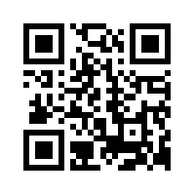

Slide 2
We invite all scientists, engineers and anyone with an interest in rheology and related areas to participate.
Symposium in honour of Prof Tam Sridhar
Abstracts open shortly

Slide 3
Themes:
Self-assembling systems (Associative polymers, surfactant solutions and liquid-crystals)
Gels, Glasses, and Granular Materials
Polymeric Fluids
Colloids, Suspensions and Emulsions
Food and Biological Rheology
Interfacial and Microrheology
Rheometry and experimental techniques
Non-Newtonian Fluid Mechanics

Slide 4
Register your details to receive updates on the conference.
For more information visit www.pacrimrheology.com
Email: rheology@pco.com.au
or call +61 2 4984 2554

